Slide 1

Heritage Institute of Technology, Kolkata
Department of
Computer Science and Engineering
XAI Based Detection of Brain Tumors using MRI Images
Mentor:
Prof. Dr. Diganta Sengupta
Presented by:
Anwesha Goswami
Jyotirmay Shrestha
Sayantika Bhunia
Sneha Lahiri

Slide 2
Table of Contents
1. Introduction
2. Motivation
3. Objectives
4. Proposed Workflow
5. Dataset Description
6. Segmentation Model
7. Grad-CAM
8. Classification Model
9. Research Gaps
10. Future Work
11. Conclusion
12. References

Slide 3
Introduction
MRI is essential for detecting brain abnormalities
Manual delineation is time-consuming and subjective
Growing demand for faster, consistent diagnostic support
Deep learning offers automated solutions for medical image segmentation
Key Challenge: Accurate segmentation is critical but remains labor-intensive

Slide 4
Motivation
Build Clinician Trust
Improve Diagnostic Accuracy
Ensure Accountability & Compliance
Enhance Human–AI Collaboration
Guide Research & Model Improvement

Slide 5
Objectives
Implement ResUNet-based model for segmentation on the BRISC dataset.
Evaluate using DSC, IoU, pixel accuracy.
Use an enhanced loss function (BCE + Dice) for better boundary precision.
Implement a ResNet-based classification model for tumor type prediction.
Implement XAI techniques (Grad-CAM, LIME, SHAP) for clinical transparency.

Slide 6
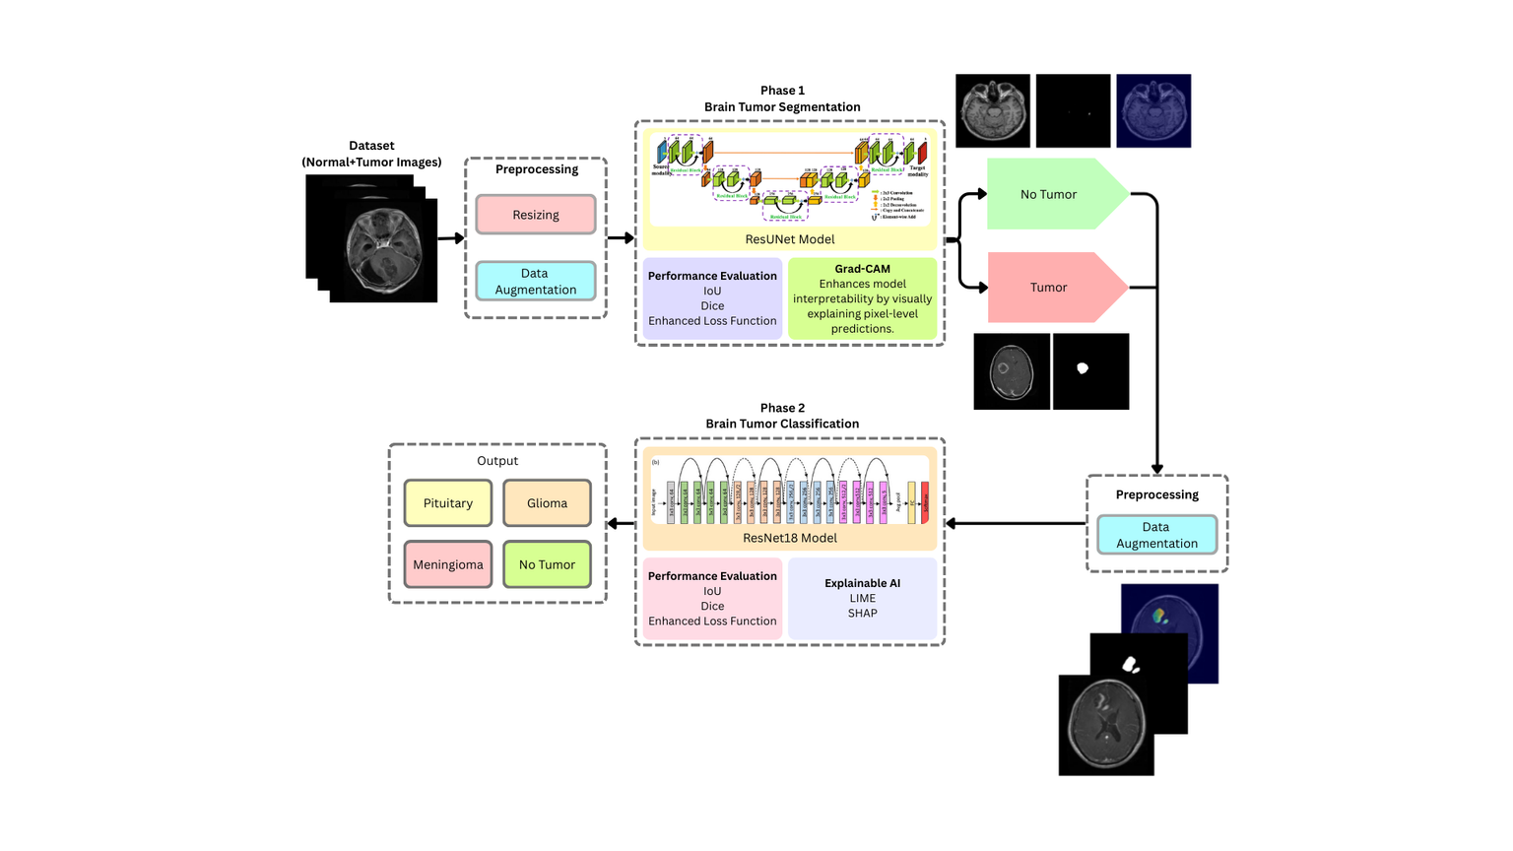
Proposed Workflow
Input: Contrast-enhanced T1-weighted Brain MRI images.
Stage 1 (Segmentation):
Preprocessing → ResUNet Model → Segmented Mask.
Processing:
Cropping the tumor region from the original MRI using the
segmentation mask.
Stage 2 (Classification):
Cropped Tumor Region → ResNet Model → Tumor Type
(Glioma, Meningioma, Pituitary, No Tumor)
Explainability:
Grad-CAM applied to both segmentation and classification
stages to highlight influential regions and improve
interpretability.
Workflow Diagram

Slide 7
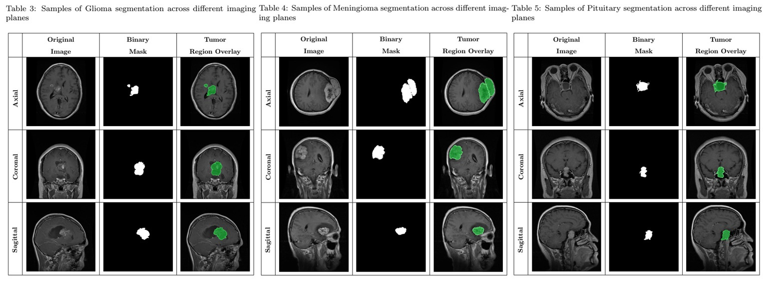
BRISC Dataset Description
The BRISC (Brain Tumor Segmentation and Classification) dataset (Fateh et al., 2025) is a large-scale, high-quality MRI dataset designed for brain tumor detection and segmentation.
Classes: Glioma, Meningioma, Pituitary.
Segmentation: 3933 for training, 860 for testing
Classification: 5000 for training, 1000 for testing
Annotation: Expert-labeled segmentation masks.
Imaging Planes: Axial, Coronal, Sagittal
BRISC Dataset Images

Slide 8
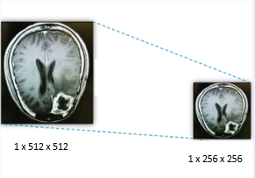
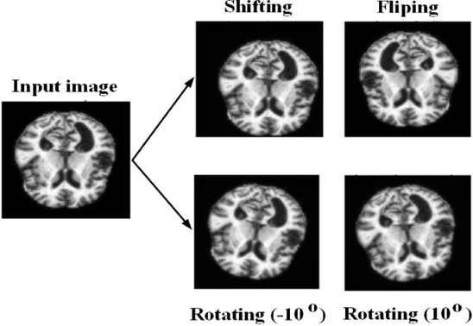
Segmentation Model
Data Preprocessing
Resizing
resized to 256 × 256 pixels.
Data Augmentation
Horizontal flipping
Vertical flipping
Rotation
Elastic deformation
Gaussian noise
Random brightness and contrast
Z-Score Normalization
Image Resizing
Source: https://www.researchgate.net/publication/362146527/figure/fig2/AS:11431281189122155@1694894202363/Example-of-resizing-an-MRI-image.jpg
Data Augmentation
Source: https://www.nature.com/articles/s41598-025-01845-y

Slide 9
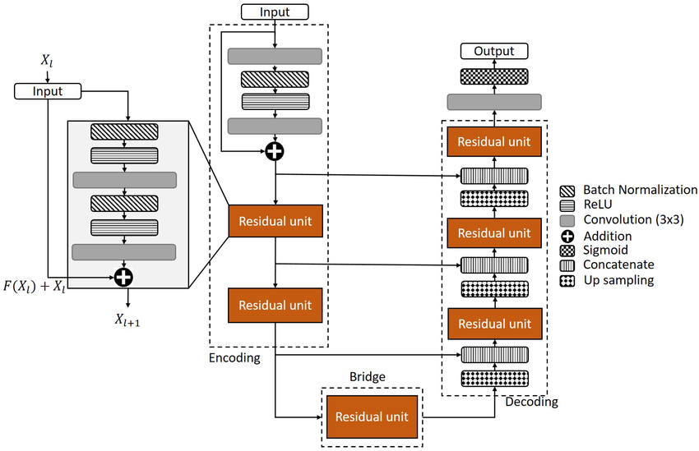
ResUNet Model Architecture
Residual Block: Adds input to output to improve feature learning and gradient flow.
Encoder: Extracts deep features using convolutional layers and residual blocks.
Bridge: Captures the highest-level abstract features before decoding starts.
Decoder: Reconstructs the segmentation map using transpose convolutions and skip connections.
Skip Connection: Concatenates encoder and decoder features to retain spatial information.
Final 1×1 Convolution: Converts decoder features into the final segmentation mask.
ResUNet Architecture Diagram
Source: https://tse4.mm.bing.net/th/id/OIP.yvycWvHtPcmkhCHG4KA6ggHaEr?cb=ucfimg2&ucfimg=1&rs=1&pid=ImgDetMain&o=7&rm=3

Slide 10
Training
Batch size: 16
Learning rate: 2e-4
Optimizer: Adam
Enhanced Loss function: We use a combined loss: BCE + Dice Loss.
Binary Cross Entropy Loss(BCE):
Helps the model learn accurate pixel-level distinctions.
Dice Loss:
Enhances boundary precision, especially for small or irregular tumors.
Final loss = weighted sum of BCE and Dice → better segmentation quality.
Scheduler: ReduceLROnPlateau(optimizer, factor=0.5, patience=2)
Epochs: 40
Testing: Evaluates the trained model on unseen images to generate segmentation masks and measure final performance

Slide 11
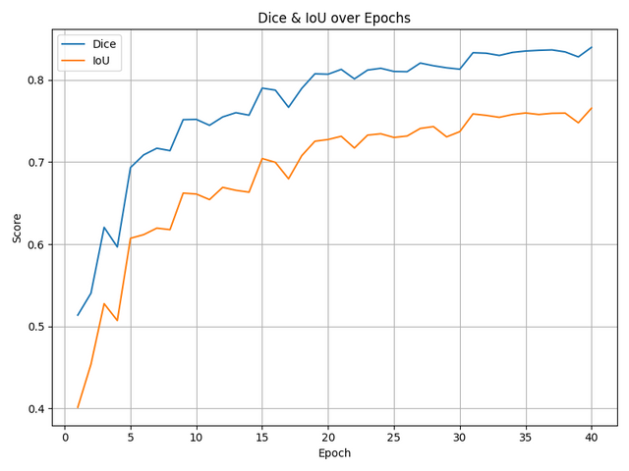
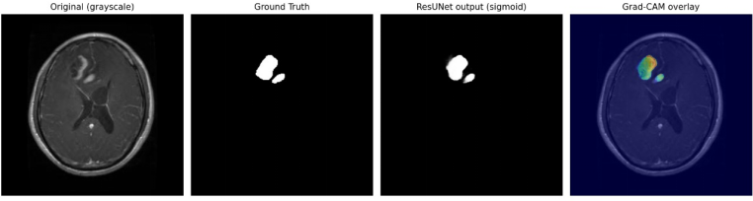
Evaluation & Results
Evaluation Metrics
Dice Similarity Coefficient (DSC)
Intersection over Union (IoU)
Pixel Accuracy (PA)
Segmentation Results
Dice Score: 0.8455
IoU: 0.7727
Pixel Acc: 99.55%
Train Loss: 0.3158
Val Loss: 0.1047
ResUNet Ouput Mask

Slide 12
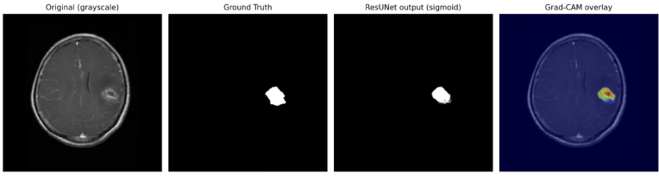
Grad-CAM
Grad-CAM Approach
Uses gradients to generate heatmaps.
Highlights regions contributing most to the segmentation decision.
Visualizes high-activation areas (Red/Yellow) vs low-activation (Blue).
XAI verifies if the model focuses on clinically relevant tumor tissues.
Grad-CAM Heatmap

Slide 13
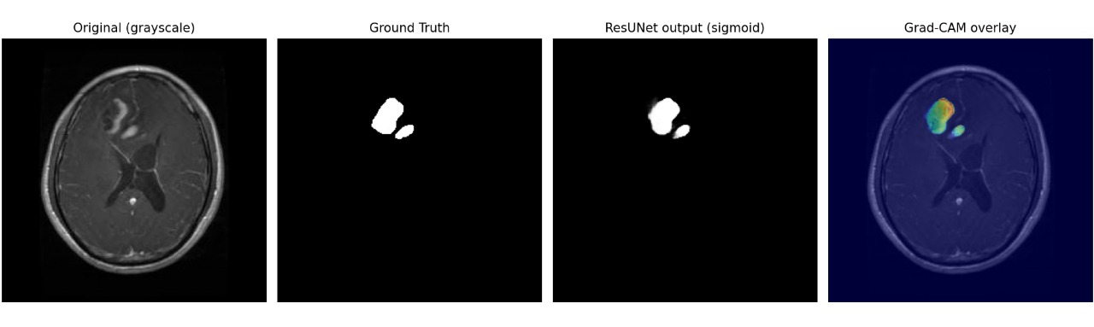
Classification Model
Data Preprocessing
Resizing
resized to 256 × 256 pixels.
Channel Conversion to 3-Channel Format
Label Encoding
Train–Validation–Test Split
Data Augmentation
Horizontal flipping
Vertical flipping
Rotation
Shift, Scale and Rotate
Normalization
Brightness and Contrast adjustment
Image Stacking

Slide 14
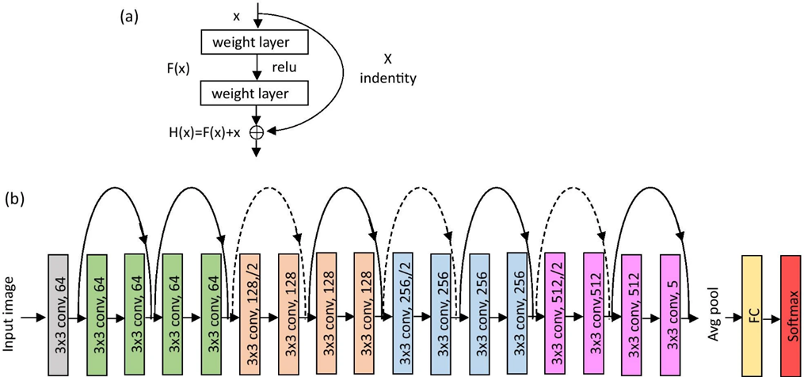
ResNet18 Model Architecture
Initial Convolution Stage
7×7 conv (stride 2), BN, ReLU
3×3 max-pool
Extracts low-level features
Residual Blocks
Identity Block: 2×3×3 conv + BN + ReLU + skip
Projection Block: stride-2 downsampling + 1×1 projection
Layer Stack
L1: 2× Identity (64)
L2: Projection → Identity (128)
L3: Projection → Identity (256)
L4: Projection → Identity (512)
Classification Head
Adaptive AvgPool → FC (512→4) → Softmax
Initialization
Kaiming Normal for all layers
ResNet18 Architecture Diagram
Source: https://www.researchgate.net/figure/a-The-basic-residual-block-b-The-ResNet18-architecture-The-numbers-in-each_fig1_352666166

Slide 15
Training
Batch size: 16
Learning rate: 1e-4
Optimizer: Adam
Loss: Cross-Entropy Loss
Scheduler: StepLR scheduler (halves LR every 7 epochs)
Epochs: 30
Fine-tuned the pretrained ResNet18 Model:
Started with a pretrained ResNet-18, adjusted it for 3-channel input and replaced the final layer to match the classes.
Trained the whole network end-to-end with Adam, scheduler, augmentations, and class-balancing so the model adapts to our dataset.
Validation:
Runs after every epoch to measure model performance on unseen data.
Uses only resizing for stable evaluation.
Computes validation loss and accuracy.
Saves checkpoints and updates the best model whenever accuracy improves.
Testing:
Performs a full evaluation on the validation set once training finishes.
Generates a classification report, confusion matrix, and predictions CSV.
Provides per-class performance and overall summary metrics.

Slide 16
Evaluation
Evaluation Metrics
Accuracy – measures the proportion of correctly classified samples.
Precision – assesses how many predicted positives are true positives.
Recall (Sensitivity) – measures the model’s ability to correctly identify positive samples.
F1-Score – harmonic mean of precision and recall, especially useful for imbalanced datasets.
Confusion Matrix – provides detailed insights into class-wise performance and misclassification patterns.

Slide 17
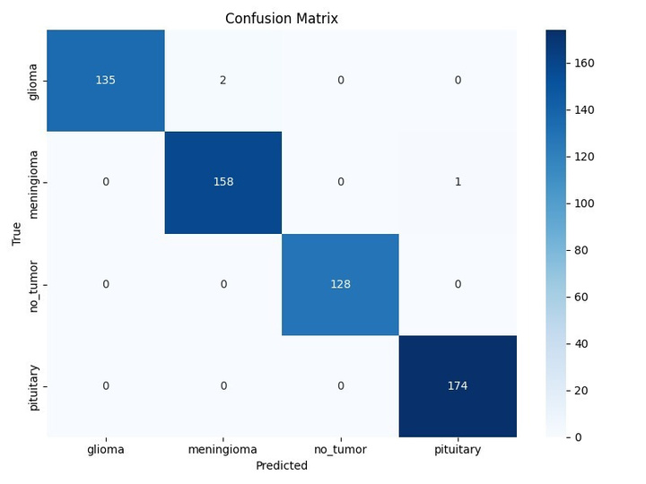
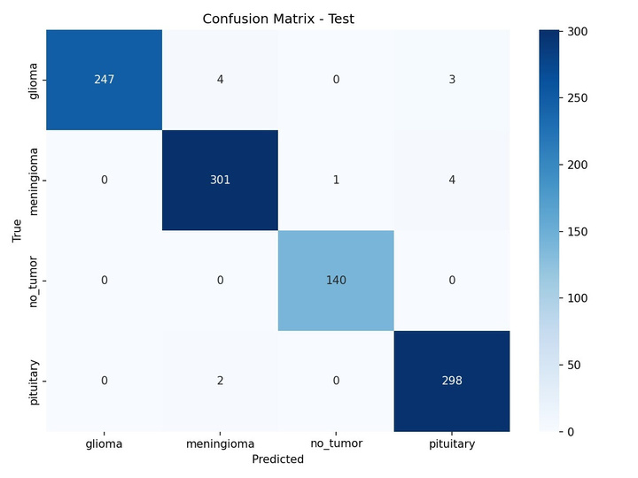
Results
The following results were achieved:
Training Accuracy: 99.08%
Test Accuracy: 98.60%
Confusion Matrix of training and testing dataset

Slide 18
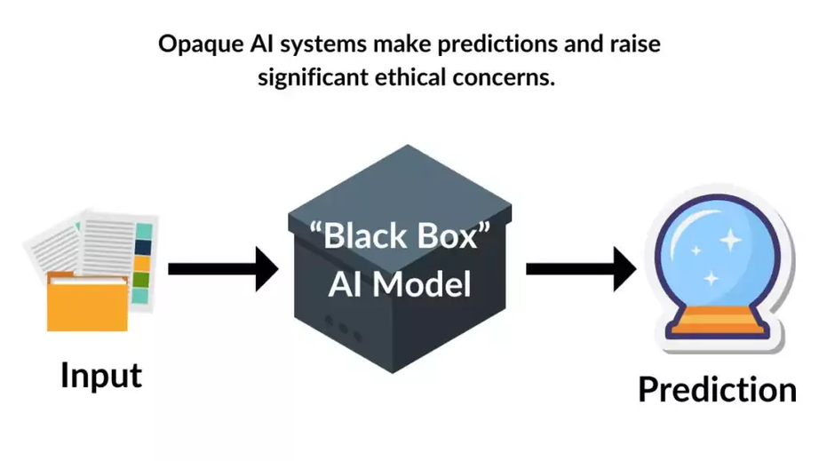
Explainable AI
Enables users to understand and trust the results and outputs generated by complex machine learning algorithms
Makes AI systems more transparent, interpretable, and accountable, in high-stakes domains like healthcare, finance, etc.
Post-Hoc Methods:
LIME (Local Interpretable Model-agnostic Explanations)
SHAP (SHapley Additive exPlanations)
ML Model as Black Box
Source: Source: https://www.mdpi.com/applsci/applsci-15-07329/article_deploy/html/images/applsci-15-07329-g002-550.jpg

Slide 19
Research Gaps
Lack of Standard Evaluation for XAI
Absence of 3D Explainability
XAI Not Integrated Into Learning
Lack of Human-in-the-Loop Validation
Poor Generalization of Explanations
Limited XAI Research for Tumor Grading & Prognosis
Lack of Real-Time or Lightweight XAI Solutions

Slide 20
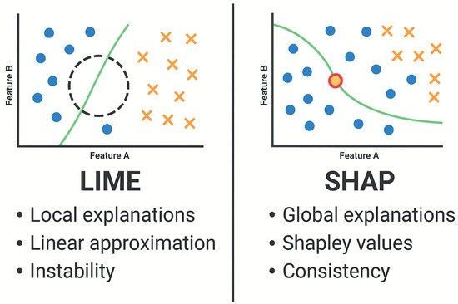
Future Work
Extend segmentation to 3D MRI volumes for improved spatial understanding and tumor consistency across slices.
Incorporate advanced architectures (e.g., nnU-net, Swin-UNet) for better feature extraction.
Develop a user-friendly interface for clinicians to upload MRI scans and view explanations.
Apply LIME for region-wise interpretability of classification predictions.
Use SHAP to quantify feature contribution and enhance trust in model decisions.
Source: https://www.mdpi.com/applsci/applsci-15-07329/article_deploy/html/images/applsci-15-07329-g002-550.jpg

Slide 21
Conclusion
A complete deep-learning pipeline was developed for brain tumor segmentation and classification using MRI.
ResUNet produced accurate tumor masks with strong Dice and IoU scores, effectively capturing shape and boundary variations.
ResNet18, trained on segmentation-guided tumor crops, achieved reliable classification across glioma, meningioma, pituitary, and no-tumor cases.
Grad-CAM provided visual explanations, improving model transparency and supporting potential clinical trust.
The integration of segmentation + classification + explainability forms a robust, interpretable, and clinically meaningful workflow for brain tumor analysis.

Slide 22
References
Zeineldin, R. A., et al., “Explainability of Deep Neural Networks for MRI Analysis of Brain Tumors: The NeuroXAI Framework,” 2022.
Asmita & Mittal, P., “From Black Box AI to Explainable AI in Neuro-Oncology: A Survey on MRI-Based Brain Tumor Detection,” 2025.
Jia, W., & Chen, Y., “Brain Tumor Identification and Classification Using Deep Learning Techniques on MRI Data,” 2020.
Iftikhar, M., et al., “Explainable CNN for Brain Tumor Detection and Classification Using MRI Images,” 2025.
Anantharajan, R., et al., “MRI Brain Tumor Detection Using Deep Learning and Segmentation Approaches,” 2024.
Road Extraction by Deep Residual U-Net, ResearchGate Preprint.
BRISC: Annotated Dataset for Brain Tumor Segmentation and Classification with Swin-HAFNet, ResearchGate, 2024.

Slide 23
Thank You!

